Slide 1
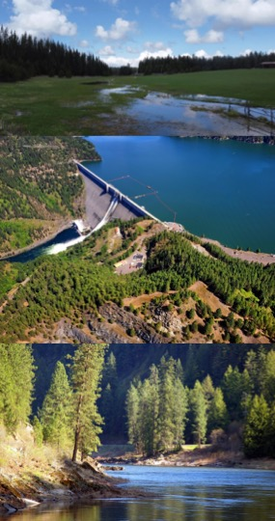






Integrated Water Quality Modeling for Multi-Objective Decision-Making in Complex River-Reservoir Systems using CE-QUAL-W2 and HEC-ResSim
Todd E. Steissberg, PhD, PE
Environmental Laboratory
U.S. Army Engineer Research and Development Center (ERDC)
U.S. Army Corps of Engineers (USACE)
May 14, 2024
Notes:
Abstract:
In the face of ongoing conflict and climate change, Ukraine faces significant environmental challenges, particularly in water resources management. The strategic rehabilitation and planning of water resources infrastructure are critical to meet diverse objectives, including flood risk management, water supply, hydropower, water quality, and ecosystem management. Advanced integrated water quality modeling can provide critical support in this endeavor. The U.S. Army Corps of Engineers' reservoir water quality models, CE-QUAL-W2 and HEC-ResSim-WQ have been designed to help navigate the complexities of aquatic system management. CE-QUAL-W2 is a two-dimensional (2D) hydrodynamics and water quality model that simulates the flow and water quality dynamics in river-reservoir systems. CE-QUAL-W2 simulates vertical stratification processes and longitudinal changes due to flow, mixing, pollutant inflows, and biogeochemical reactions. It enables detailed study of temperature stratification, contaminant distribution, and nutrient dynamics across diverse aquatic environments including rivers, reservoirs, lakes, and estuaries. CE-QUAL-W2 simulates water quality variables such as temperature, dissolved oxygen, nutrients (nitrogen and phosphorus compounds), algae, and organic matter, providing insights into ecosystem dynamics critical for effective water quality management. The model also incorporates features relevant to fish habitat, selective withdrawal strategies, hypolimnetic aeration, and the dynamics of various algae types, as well as sediment diagenesis processes critical for understanding harmful algal bloom dynamics. Complementing CE-QUAL-W2, HEC-ResSim-WQ incorporates water quality objectives into the reservoir operations decision-making process. HEC-ResSim-WQ is a one-dimensional reservoir operations water quality model, simulating vertical stratification processes in reservoirs and longitudinal changes in the unstratified river reaches. CE-QUAL-W2 and HEC-ResSim can be used in conjunction to provide a comprehensive understanding of water quality and ecosystem dynamics in river-reservoir systems and help address the multifaceted water resource management challenges in post-conflict Ukraine. By leveraging the detailed environmental simulation capabilities of CE-QUAL-W2 alongside the operational features of HEC-ResSim, stakeholders can engage in informed multi-objective decision-making for complex river-reservoir systems. This integrated modeling approach can support Ukraine's environmental recovery and sustainability efforts, providing a foundation for advanced water resource management practices capable of addressing multi-faceted challenges.
Speaker Biography:
Dr. Todd Steissberg is a Research Environmental Engineer at the U.S. Army Corps of Engineers (USACE), Engineer Research and Development Center (ERDC). Dr. Steissberg leads the Ecohydrology Team at ERDC's Environmental Laboratory that, in collaboration with other federal and academic partners (USACE-HEC, USACE-ERDC-CHL, Portland State University, ASU, USGS, USBR, and others), develops and applies water quality and environmental systems models for rivers, reservoirs, and watersheds. The objective of his research is to provide interdisciplinary teams with the tools and methods needed to perform integrated watershed-scale environmental impact assessments, improve water quality management and real-time operations, and design and implement ecosystem restoration projects that incorporate natural and nature-based features (NNBF) to improve the health and resiliency of ecosystems and communities.
Dr. Steissberg obtained his B.S. in Civil Engineering from Washington State University. He earned his M.S. and Ph.D. in Civil and Environmental Engineering from University of California, Davis, while serving as a NASA Earth System Science fellow at NASA/JPL, researching remote sensing of physical limnology and water quality processes. As a Postdoctoral Researcher at the UC Davis Tahoe Environmental Research Center, he developed methods to characterize the spatial-temporal variability of water quality using satellite and field measurements. Dr. Steissberg lead development and application of water quality models and geospatial tools as a Senior Hydraulic Engineer at the U.S. Army Corps of Engineers' Hydrologic Engineering Center (USACE-HEC), transitioning to ERDC in 2019, to expand this work to address complex issues in water quality, ecosystem restoration, and environmental resiliency and adaptation of freshwater and coastal ecosystems, civil works infrastructure, and military installations.
Dr. Steissberg is the lead developer of ERDC's CE-QUAL-W2 model and the Corps Library for the Environmental Analysis and Restoration of Watersheds (ClearWater). He continues to lead development and application of water quality capabilities for the widely used hydraulic and hydrologic (H&H) models developed by the USACE Hydrologic Engineering Center (HEC-RAS, HEC-ResSim, and HEC-HMS), and his team is developing new water quality and vegetation modeling capabilities for the ERDC Coastal and Hydraulic Laboratory's (CHL) Gridded Surface Subsurface Hydrologic Analysis (GSSHA) program.

Slide 2
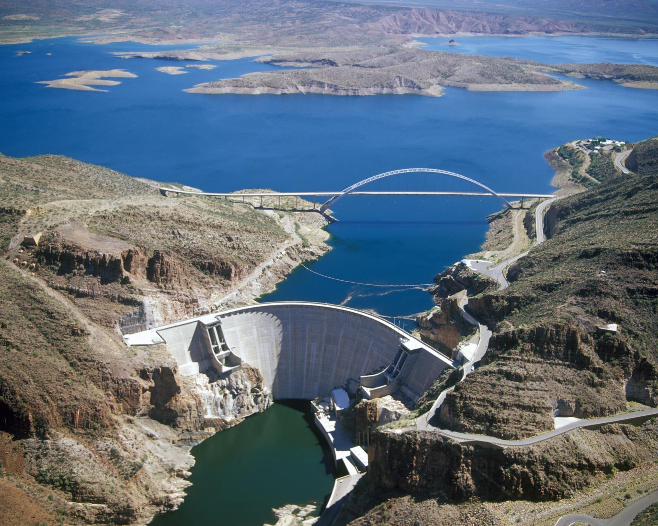

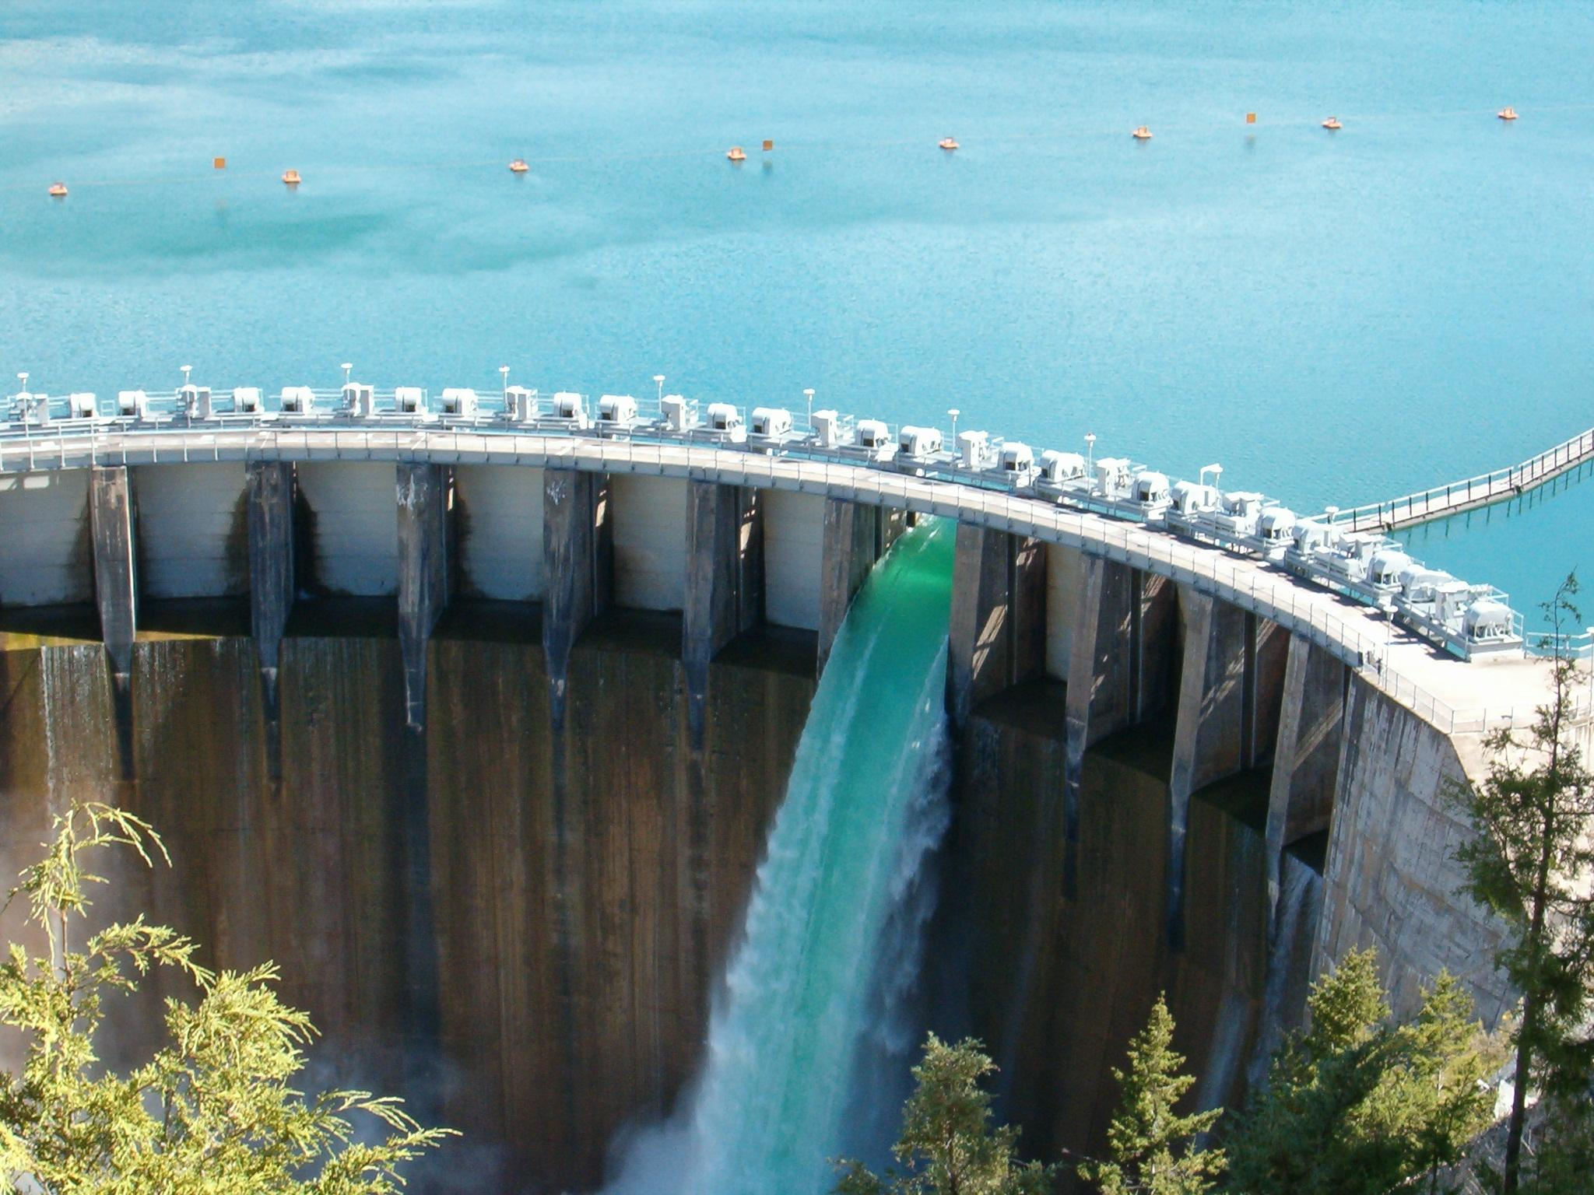
Water Quality Modeling
Water quality modeling combines mathematical descriptions of the physical and biogeochemical processes to characterize behavior of a waterbody or water resource.
Water resource and water quality models have been developed to understand and predict the processes in reservoirs, rivers, and watershed runoff.
The following fields comprise the body of knowledge required for accurate water quality modeling and analysis:
Hydrodynamics (physical limnology)
Meteorology
Aquatic chemistry (chemical limnology)
Aquatic biology (biological limnology)
Geology (sedimentation, sediment settling, resuspension, and transport)
Mathematics and numerical methods
Statistics
Flows influence water quality
Water quality must influence flows
Notes:
Water quality modeling is a process of using mathematical and computational models to simulate and predict the behavior and characteristics of water quality in natural or engineered water systems. It involves the development and application of mathematical equations, algorithms, and computer simulations to understand and predict the distribution, transport, and fate of various pollutants, contaminants, and constituents in water bodies.
Water quality models typically consider factors such as physical processes (e.g., flow dynamics, mixing), chemical reactions (e.g., nutrient cycling, pollutant transformation), and biological processes (e.g., microbial activity, ecosystem interactions) that influence water quality. These models are designed to simulate the complex interactions and dynamics of water quality parameters, such as dissolved oxygen levels, pH, temperature, nutrients, sediments, and contaminants.
Water quality models can be applied to a wide range of water systems, including rivers, lakes, reservoirs, estuaries, coastal zones, and groundwater systems. They are used by scientists, engineers, and decision-makers to assess the impacts of various factors, such as land use changes, pollution sources, climate change, and management practices, on water quality. Water quality modeling helps in understanding and predicting the effectiveness of different management strategies and interventions for improving or maintaining water quality.
The input data for water quality models often include information on hydrology, water flow rates, pollutant sources, meteorological data, and water quality measurements. These models incorporate physical laws, chemical kinetics, biological processes, and empirical relationships to simulate the behavior and interactions of water quality parameters over time and space.
By using water quality models, researchers and practitioners can gain insights into the factors influencing water quality, assess the potential impacts of different scenarios, and make informed decisions regarding water management, pollution control, and restoration efforts. Water quality modeling plays a crucial role in supporting the development and implementation of effective strategies to protect and improve water resources for human and ecological health.

Slide 3
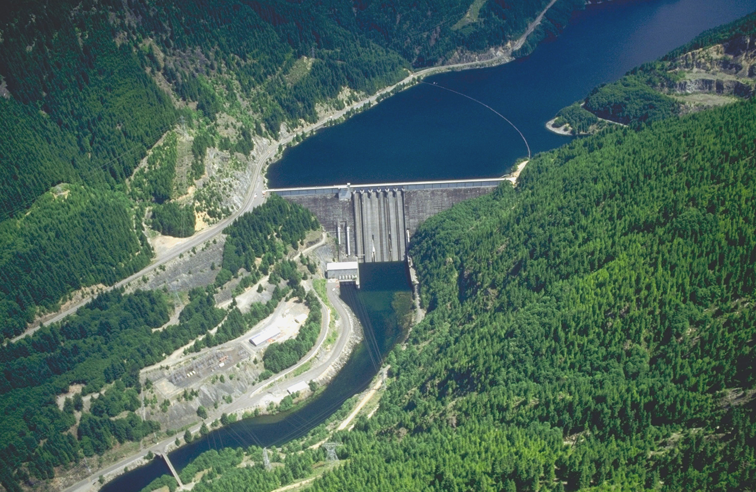
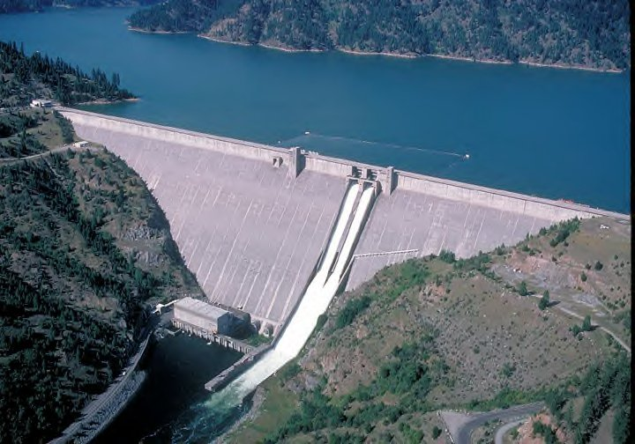
Benefits of Water Quality Modeling
Interpolation
Observed data is sparse in space and time.
Interpolation addresses questions like:
Where are the best locations for sampling?
Where are the most severe water quality problems occurring?
Extrapolation
Forecast water quality in the future.
Predict water quality for different water management scenarios
Extrapolation answers questions like:
How will the watershed function under different climate forcing conditions?
How will the ecosystem respond if flow allocations are changed, hydropower withdrawals increased, and releases altered to meet ecosystem restoration targets (e-flows)?
Improved understanding of the system.
Detroit Dam, Oregon
Dworshak Dam, Idaho
Notes:
Water quality modeling serves three major purposes: interpolation, extrapolation, and increasing understanding of the system.
1. Interpolation: Water quality modeling can interpolate data, meaning it can estimate values between measured data points. By utilizing mathematical algorithms and statistical techniques, models can fill in gaps in observed data and provide estimates of water quality parameters at unsampled locations or time intervals. Interpolation allows for a more comprehensive understanding of water quality patterns across a water system, even in areas where direct measurements are limited.
2. Extrapolation: Water quality modeling enables extrapolation, which involves predicting water quality conditions beyond the available data range. Models can simulate the behavior of water quality parameters under different scenarios, including future conditions or locations where no measurements have been made. This extrapolation capability is useful for assessing the potential impacts of changes in pollutant sources, land use patterns, or climate on water quality. It helps decision-makers anticipate and plan for future water quality challenges and supports proactive management strategies.
3. Increasing Understanding of the System: Water quality modeling plays a crucial role in increasing our understanding of complex water systems. By incorporating various physical, chemical, and biological processes, models simulate the interactions and dynamics of water quality parameters. They help identify key drivers, relationships, and mechanisms influencing water quality patterns and responses. Through modeling, researchers gain insights into the underlying processes and develop a deeper understanding of how different factors interact to shape water quality. This understanding enhances the ability to design effective management strategies, implement targeted interventions, and protect water resources.
Water quality modeling offers several benefits for understanding and managing water systems:
1. Prediction and Assessment: Water quality models provide a means to predict and assess the behavior of water quality parameters under different scenarios. They can simulate the impacts of pollutant sources, land use changes, climate change, and management strategies on water quality. This information helps in evaluating the effectiveness of various interventions and identifying potential risks to water resources.
2. Decision Support: Water quality models serve as valuable tools for decision-making. They provide scientific evidence and insights to support informed decisions regarding water management, pollution control, and restoration efforts. By simulating the outcomes of different management options, models help stakeholders make informed choices and prioritize actions for achieving desired water quality objectives.
3. Cost-Effectiveness: Water quality modeling can be a cost-effective approach compared to extensive field monitoring campaigns. Models allow for the simulation of various scenarios and interventions, reducing the need for costly and time-consuming field experiments. By optimizing resource allocation, water quality modeling helps maximize the efficiency of water management investments.
4. Long-Term Planning: Water quality models enable long-term planning and management strategies. They can simulate water quality dynamics over extended periods, considering both short-term and long-term impacts. By identifying trends, patterns, and potential future challenges, models aid in the development of robust strategies for sustainable water resource management.
5. Environmental Protection: Water quality modeling supports efforts to protect and restore the environment. By simulating the impacts of pollutant sources, models can assist in identifying critical areas or sources of pollution that require mitigation. This information helps in designing targeted pollution control measures and implementing strategies to safeguard aquatic ecosystems and protect public health.
6. Regulatory Compliance: Water quality models play a crucial role in regulatory compliance. They help assess compliance with water quality standards and regulations by simulating the expected levels of pollutants and evaluating the effectiveness of pollution control measures. Models provide a scientific basis for determining compliance, supporting regulatory decision-making processes.
7. Research and Development: Water quality modeling drives advancements in research and development. Models facilitate the exploration of complex interactions among water quality parameters, aiding in the discovery of new insights and understanding of ecosystem dynamics. By incorporating new data, scientific knowledge, and modeling techniques, researchers continuously refine and improve the accuracy and capabilities of water quality models.
In summary, water quality modeling offers three major uses: interpolation, extrapolation, and increasing understanding of the system. It fills in data gaps, estimates values at unsampled locations or time intervals, and predicts water quality under different scenarios. Additionally, modeling helps researchers gain insights into the underlying processes and mechanisms, enhancing our understanding of water systems and supporting informed decision-making for sustainable water resource management. Water quality modeling offers numerous benefits, including the ability to predict and assess water quality dynamics, support decision-making, optimize resource allocation, aid in long-term planning, protect the environment, ensure regulatory compliance, and advance research and development in the field of water quality management.

Slide 4
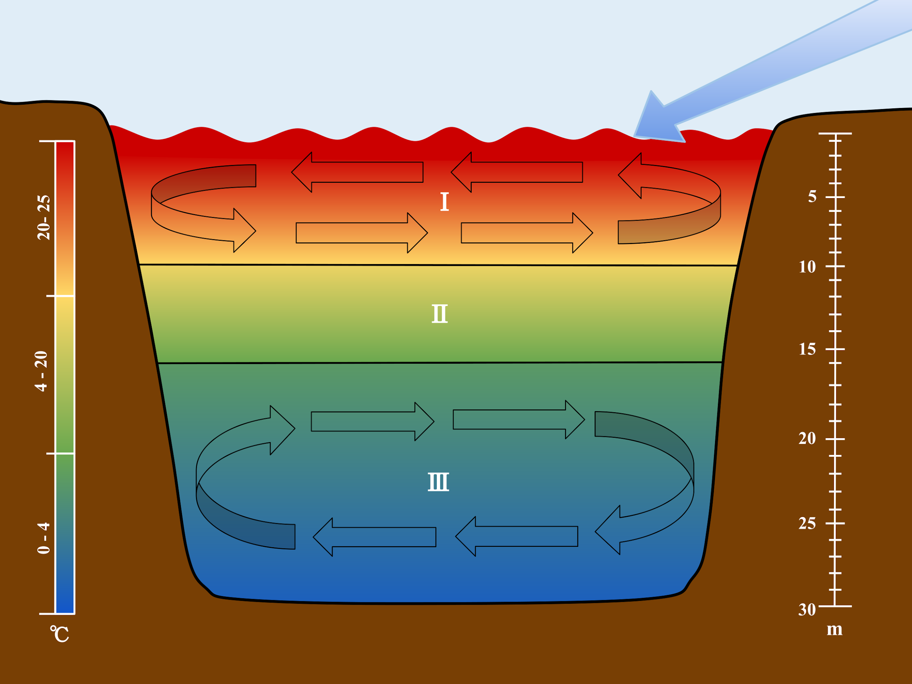
Thermal Stratification
Lakes and reservoirs in temperate climates tend to thermally stratify vertically during the spring and summer. A conceptual model of their stratification divides the water body into three vertical layers:
The epilimnion, a warm surface layer
The hypolimnion, a cool bottom layer
The metalimnion, the layer in between the top and bottom layers. This layer encompasses the thermocline, where the temperature suddenly decreases sharply with depth.
Lake stratification varies continually. It is often described by the depth and strength of the thermocline.
The seasonal thermocline is characterized by the average depth and strength over a season.
The diurnal thermocline varies throughout the day.
Notes:
Vertical stratification in water bodies refers to the layering or separation of water into distinct horizontal zones based on differences in physical and chemical properties along the vertical axis. These variations in properties such as temperature, density, dissolved oxygen, and nutrient concentrations create distinct layers or strata within the water column.
Vertical stratification occurs due to the unequal distribution of energy and inputs within the water body. Factors such as solar radiation, wind, and differences in water source inputs can contribute to variations in temperature, salinity, and other properties. These variations, in turn, lead to the formation of distinct layers.
Typically, water bodies exhibit three main vertical zones or layers:
1. Epilimnion: The uppermost layer of a stratified lake or reservoir is called the epilimnion. It is characterized by warmer temperatures, higher oxygen levels, and increased light penetration. This layer is generally well-mixed by wind and wave action, allowing for biological productivity and supporting the growth of plants and algae.
2. Metalimnion (Thermocline): The metalimnion, also known as the thermocline, is the transition layer between the epilimnion and the hypolimnion. It is a zone of rapid temperature change, where water temperature decreases rapidly with depth. The metalimnion often acts as a barrier to vertical mixing, as it represents a layer of rapid temperature change that limits the exchange of heat and nutrients between the upper and lower layers.
3. Hypolimnion: The hypolimnion is the deeper layer of a stratified water body, lying beneath the metalimnion. It is characterized by cooler temperatures, reduced oxygen levels, and limited light penetration. The hypolimnion is typically isolated from surface influences and exhibits little vertical mixing. Nutrients in this layer can become depleted over time due to limited circulation, leading to reduced biological activity.
Vertical stratification in water bodies has significant ecological implications. It influences the distribution of aquatic organisms, nutrient cycling, oxygen availability, and the overall health and functioning of the ecosystem. Understanding and monitoring vertical stratification is crucial for managing water quality, predicting algal blooms, and assessing the impacts of environmental changes on aquatic ecosystems.

Slide 5
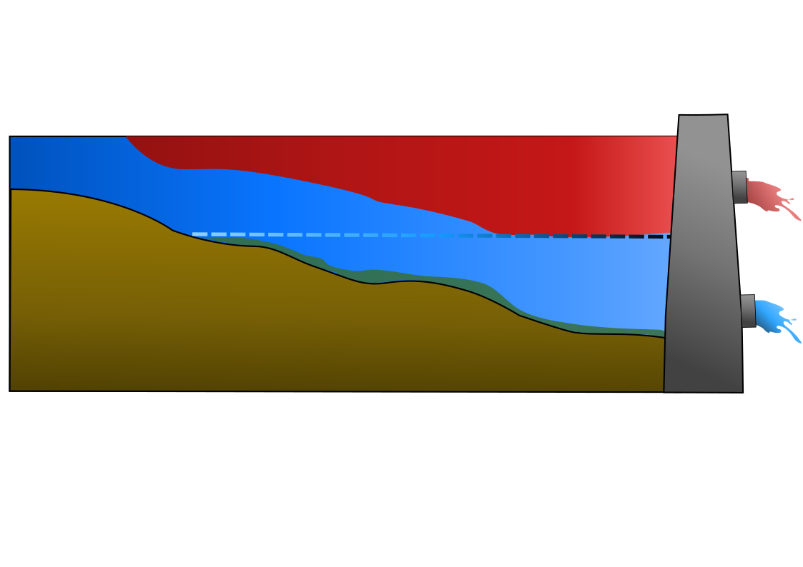
Reservoir Processes and Zones
Riverine zone
River-like flows within channel
Minimum requirement: 1D river model (segments)
Lacustrine zone
Lake-like system, vertically stratified, slow flows
Minimum requirement: 1D reservoir model (layers)
Transition zone
Stratification and downstream flows important
Minimum requirement: 2D model (layers and segments)
Riverine
Transition
Lacustrine
Graphic by Lauren Melendez
Reservoir system with important flow, WQ, and ecosystem processes for each of three zones.
Notes:
1D river model used for channels in a reservoir system
2D river model used for floodplain simulation
2D reservoir model used for large stratified reservoirs
Notes:
In a river-reservoir system, three main zones can be identified:
1. Riverine Zone: The riverine zone refers to the section of the system that encompasses the flowing river upstream of the reservoir. This zone is characterized by the dynamics of a free-flowing river, including variations in water flow, sediment transport, and ecological processes. It is influenced by upstream tributaries, land use patterns, and natural features within the river's catchment area. The riverine zone often exhibits seasonal variations in flow and water quality, and it plays a crucial role in delivering sediment, nutrients, and organic matter to the reservoir.
2. Lacustrine Zone: The lacustrine (or reservoir) zone encompasses the area within the reservoir itself. It is the portion of the river-reservoir system where water is impounded and stored. Reservoirs are typically created by constructing dams across rivers to regulate water flow, store water for various purposes (e.g., drinking water supply, hydropower generation, flood control), and manage water resources. The lacustrine zone exhibits characteristics distinct from the riverine zone, including slower water flow, reduced sediment transport, and altered ecological dynamics. Water quality parameters such as temperature, dissolved oxygen, and nutrient concentrations may also differ from those in the riverine zone.
3. Transition Zone: The transition zone, also known as the river-reservoir interface or the littoral zone, is the region where the river and the reservoir meet. It represents the transitional area between the flowing river and the impounded water in the reservoir. The transition zone is characterized by dynamic processes influenced by both riverine and reservoir dynamics. It often exhibits characteristics of both systems, including variations in flow velocity, sediment deposition, and ecological communities. The transition zone is ecologically significant, as it serves as a habitat for diverse aquatic species and provides important ecological functions such as nutrient processing and sediment trapping.
Understanding and managing the interactions and dynamics within these three zones are crucial for effective river-reservoir system management. It involves considering factors such as water flow regulation, sediment transport, water quality variations, and ecological processes in both the riverine and reservoir environments.

Slide 6
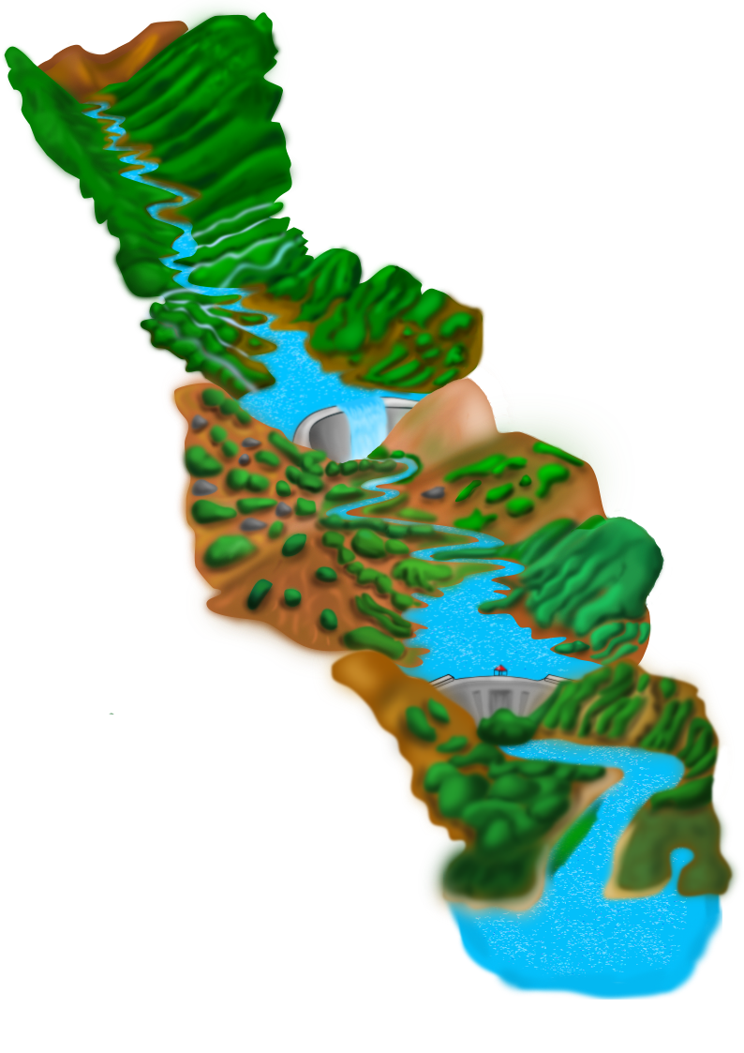
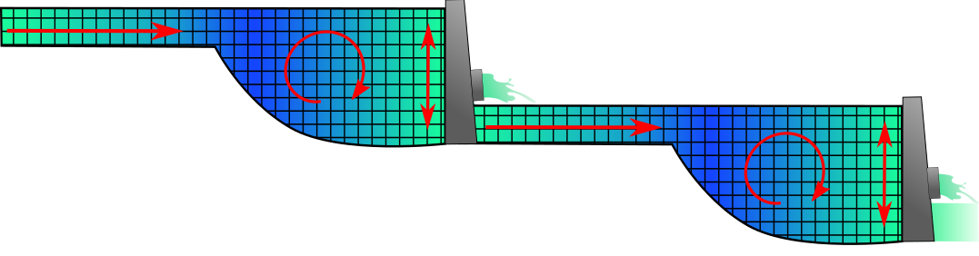
Model Dimensions: River-Reservoir System
Unstratified river/reservoir reaches:
May be modeled as 1D water bodies (segments)
Stratified reaches:
May be modeled as 1D reservoirs (layers) for real-time release decision-making to meet downstream objectives
To characterize and understand in-reservoir processes, reservoirs need to be modeled as 2D water bodies (layers and segments)
Ensures accuracy, capturing important in-reservoir processes (mixing, pollutants, inflows, etc.)
Identifies vulnerabilities and restoration/management options (e.g., velocities and temperature for HAB management)
1D Reservoir
1D River
2D Reservoir
1D Reservoir
1D River
2D Reservoir
Graphics by Lauren Melendez

Slide 7
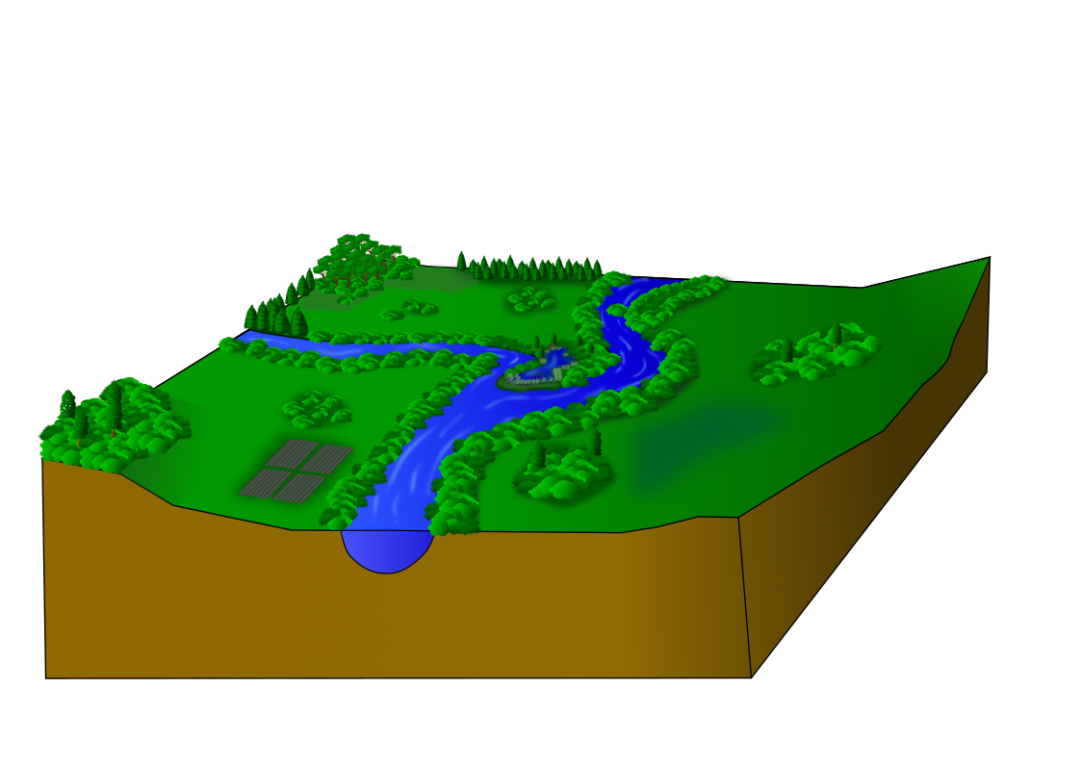

Model Dimensions: River-Floodplain System
Unstratified river channels are often modeled as 1D water bodies, varying from upstream to downstream
Hydrologic connectivity across the floodplain is important
Floodplains need to be modeled as 2D water bodies, varying in all directions across the landscape
2D River (Floodplain, Wetlands)
1D River (Channel)
Graphics by Lauren Melendez

Slide 8
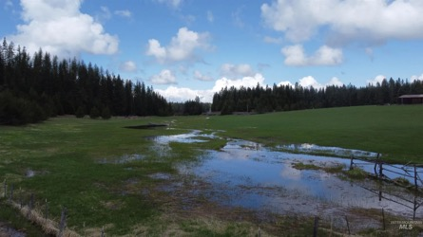
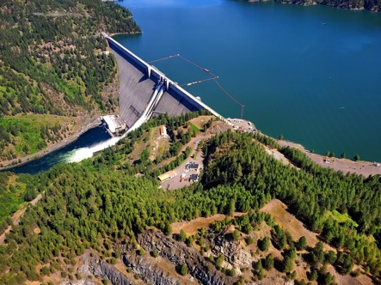
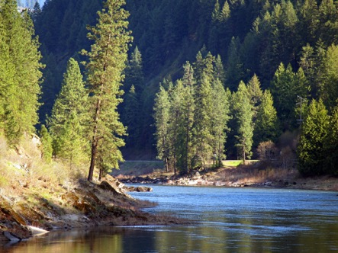
ClearWater: Next Generation Integrated Water Quality Modeling
ClearWater: Corps Library for Environmental Analysis and Restoration of Watersheds
Purpose: Link environmental models with existing water resources models that simulate runoff, rivers, and reservoir hydraulics and hydrology
ClearWater provides environmental simulation capabilities that are designed to leverage existing water resources models.
The ClearWater water quality modules simulate constituent kinetics, heat budget processes, and vegetation growth cycles. Capabilities include:
NSM: Nitrogen, phosphorus, and carbon cycling; dissolved oxygen, algae, etc.
TSM: Temperature (heat budget)
GSM: General Constituents
CSM: Organic and inorganic contaminants
MSM: Mercury
ClearWater contains legacy modules written in Fortran and C++ and next-generation modules written in Python (NSM and TSM)
Engine computes the transport (advection and diffusion) of heat and constituent mass across the watershed
Data visualization capabilities
Framework to integrate multiple models.
Runoff
Reservoirs
Rivers

Slide 9



Integrated Environmental Modeling
Water Quality
Models
Temperature
Nutrients
Dissolved Oxygen
Algae
Contaminants
Water Resources Models
Ecological Models

Slide 10
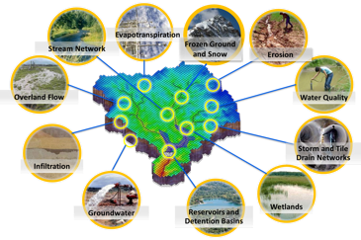
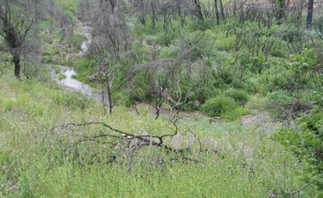
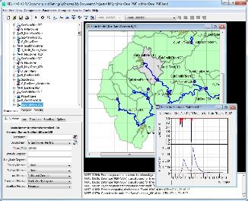

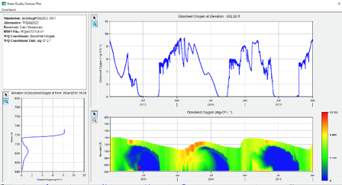
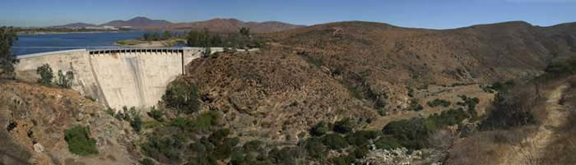
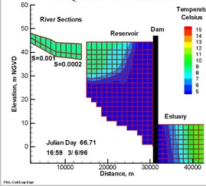
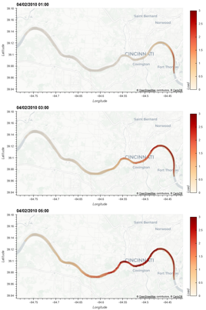
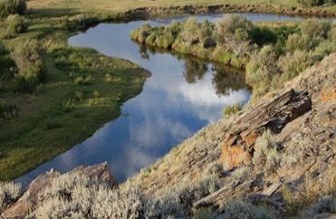
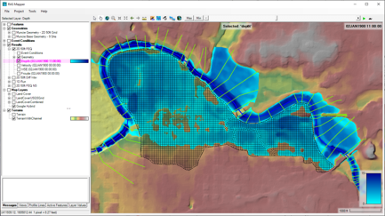
Water Quality and Environmental Systems Modeling
Temperature
Nutrients
Dissolved Oxygen
Algae
Metals
Contaminants
ERDC’s Corps Library for Environmental Analysis and Restoration of Watersheds (ClearWater) provides environmental simulation capabilities that leverage existing hydrologic and hydraulic (H&H) models.
Water quality modeling tools:
Watershed Runoff:
GSSHA: Surface and sub-surface water quality modeling
HEC-HMS: Surface runoff temperature modeling
Reservoirs:
CE-QUAL-W2: 2D reservoir-river hydrodynamics and water quality modeling
HEC-ResSim: Reservoir operations and water quality modeling
Rivers and Floodplains:
HEC-RAS: 1D River hydraulics and water quality & vegetation modeling
ClearWater-Riverine: 2D River-floodplain hydraulics and water quality modeling with HEC-RAS-2D
Estuary
Key: ERDC-EL – ERDC-CHL – HEC

Slide 11
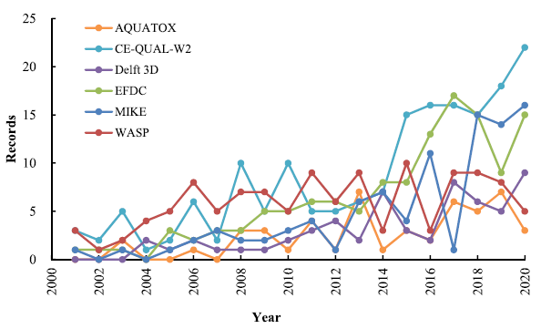
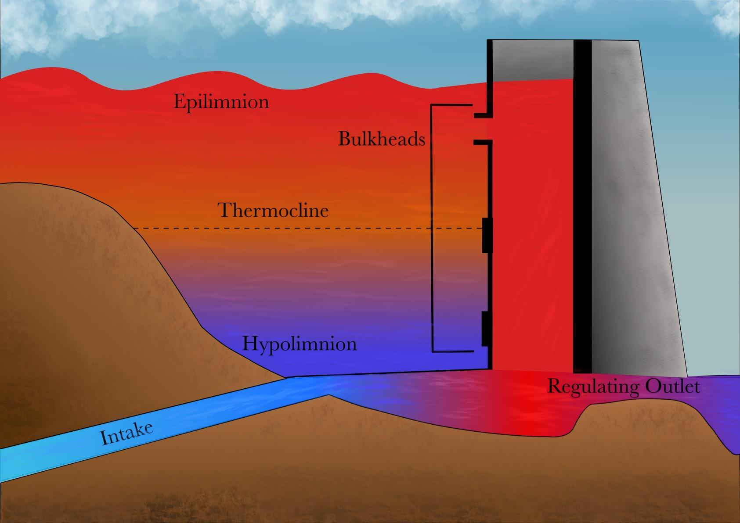
CE-QUAL-W2
CE‐QUAL‐W2 is a two‐dimensional (2D), longitudinal/vertical, hydrodynamics and water quality model that enables characterization of vertical and longitudinal changes in reservoirs.
The model assumes reservoirs are well mixed laterally, with no variation from one channel side to the other in a layer (vertical) and segment (longitudinal).
CE-QUAL-W2 has been applied to rivers, lakes, reservoirs, and estuaries.
Ecological Modelling 466 (2022) 109888

Slide 12
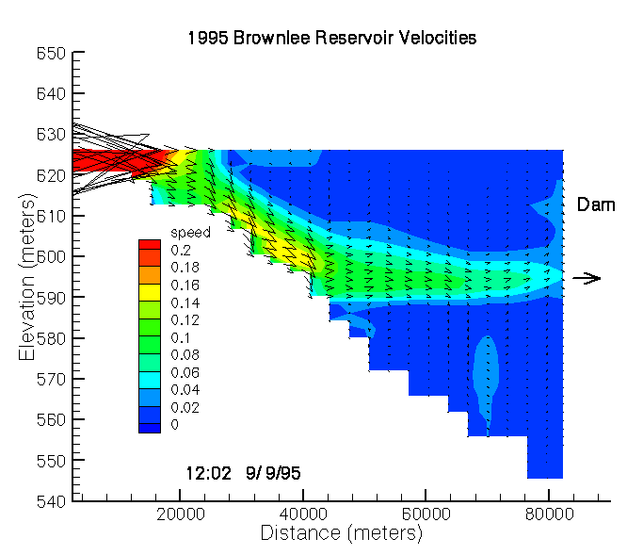
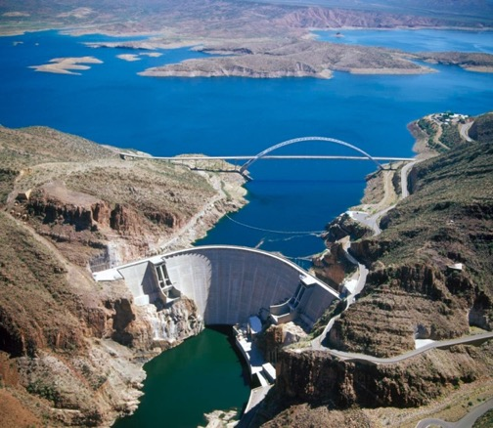
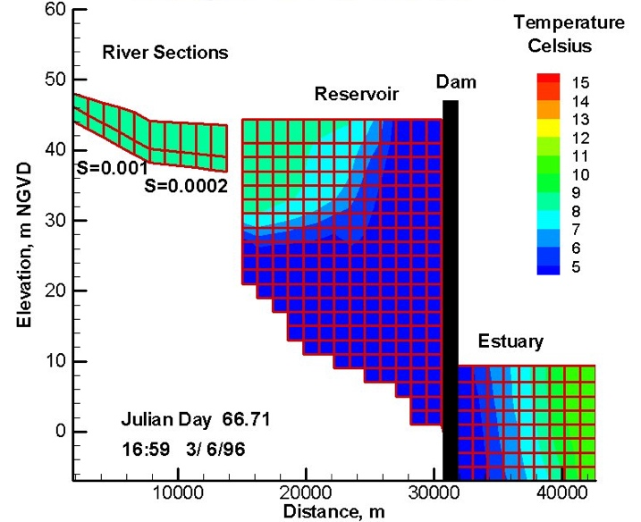
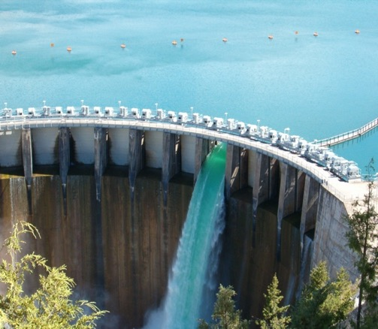
CE-QUAL-W2 Capabilities
Longitudinal-vertical hydrodynamics and water quality in stratified and non-stratified systems
Nutrients-dissolved oxygen-organic matter interactions
Fish habitat
Selective withdrawal from stratified reservoir outlets
Hypolimnetic aeration
Multiple algae, epiphyton/periphyton, zooplankton, and macrophytes
CBOD
Sediment diagenesis model
Generic water quality groups
Internal dynamic pipe/culvert model
Hydraulic structures (weirs, spillways) algorithms, including a dynamic shading algorithm based on topographic and vegetative cover.
Water age – Useful for forensic analyses

Slide 13
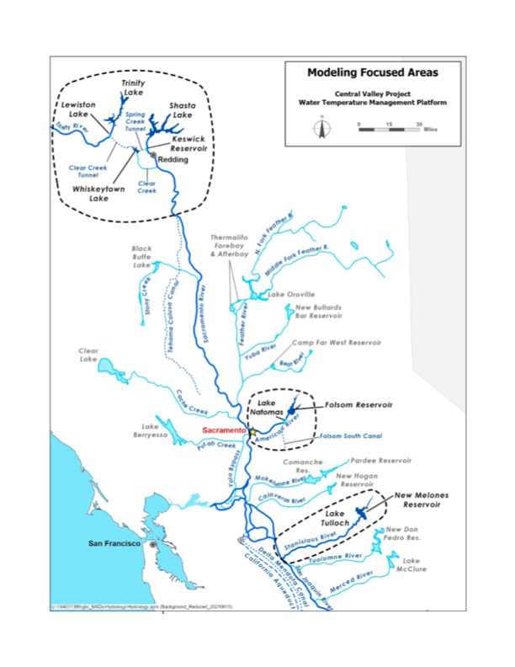
Past and Current Applications of CE-QUAL-W2
CE-QUAL-W2 is widely used by USACE and other federal, state, and local agencies for environmental impact assessments, planning studies, etc. Agencies that use CE-QUAL-W2 as their standard reservoir water quality model include:
U.S. Geological Survey (USGS)
U.S. Bureau of Reclamation
U.S. Environmental Protection Agency (EPA)
State of California
More than 1,100 model applications have been developed worldwide for reservoirs, rivers, estuaries, and other water bodies since CE-QUAL-W2 was released in 1986.
CE-QUAL-W2 is also used as a research tool by researchers at universities and other organizations.
At least 1,500 publications utilized or cited CE-QUAL-W2 in the year 2022 alone.
Recent Studies:
Water Temperature Modeling Platform, California Central Valley Project (USBR and State of California): This platform applies CE-QUAL-W2 for ongoing and future operations decision-making
USACE Northwest Division, Columbia and Snake River Watershed
Columbia System Reservoir Operation (CRSO) Project
Columbia River Treaty (CRT) Project
Philadelphia District, Lehigh River Water Quality Modeling
Region of Application:
Water Temperature Modeling Platform
California Central Valley Project

Slide 14
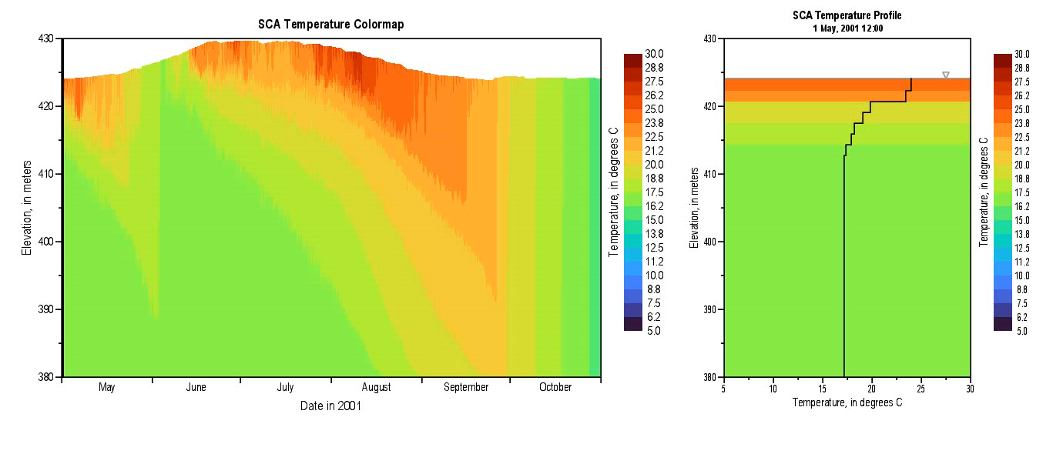
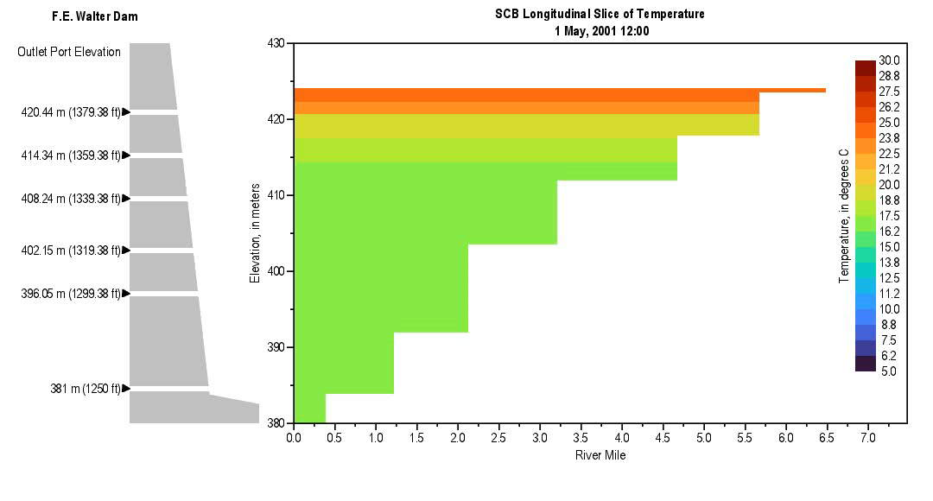
CE-QUAL-W2 Model Benefits
CE-QUAL-W2 has been extensively used and tested on over 1,100 water bodies since it was first released in 1986.
CE-QUAL-W2 enables detailed study of temperature stratification, contaminant distribution, and nutrient dynamics across diverse aquatic environments including rivers, reservoirs, lakes, and estuaries.
In contrast with reservoir models with 1D hydrodynamics, CE-QUAL-W2 accurately simulates vertical and longitudinal transport of constituents, which can be as important as chemical kinetics in accurately simulating water quality.
This is important where thermal and/or water quality gradients exist due to pollutant inflows and/or short reservoir retention times.
The model also incorporates advanced features relevant to fish habitat, selective withdrawal strategies, hypolimnetic aeration, and the dynamics of various algae types, as well as sediment diagenesis processes critical for understanding harmful algal bloom dynamics.

Slide 15
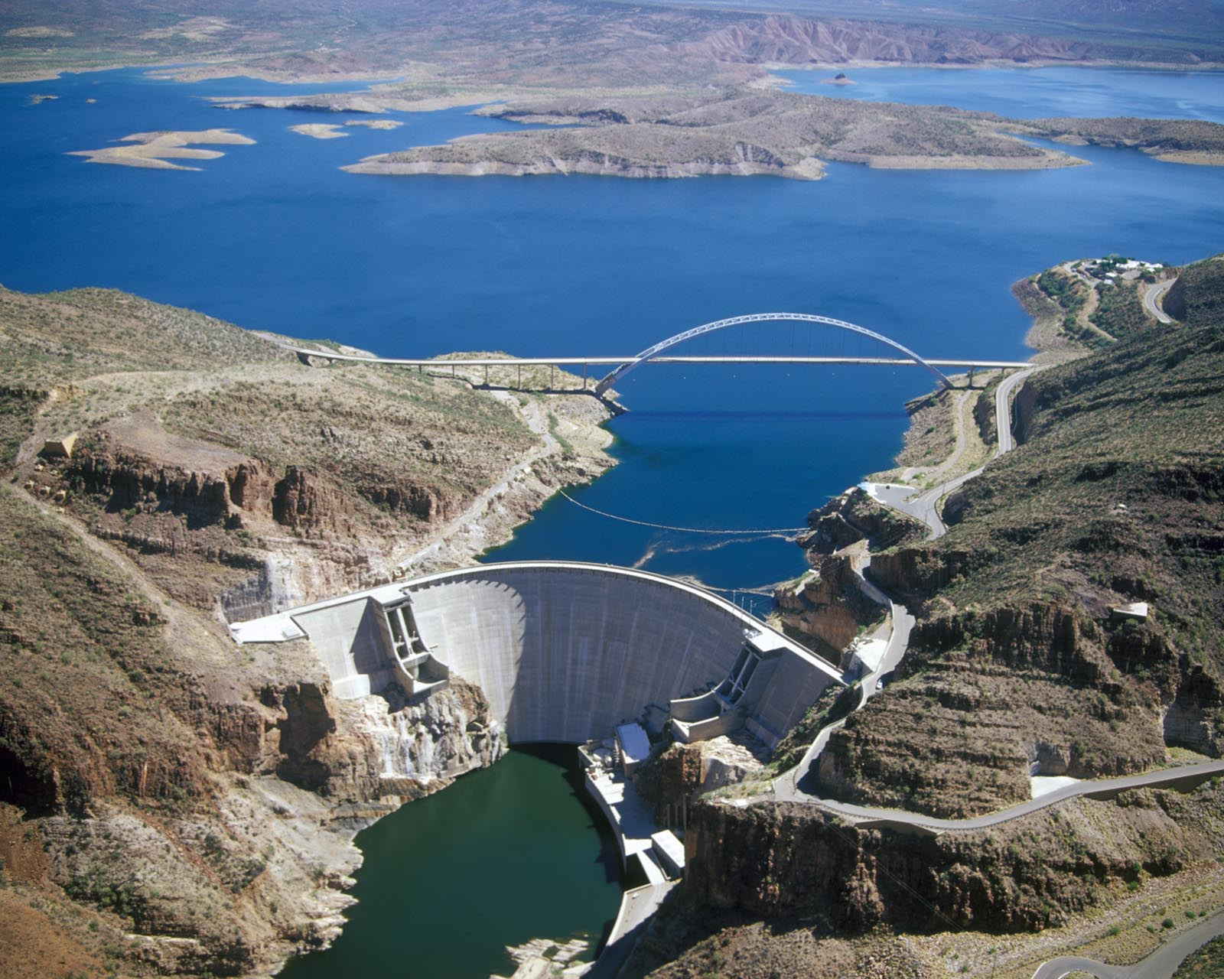
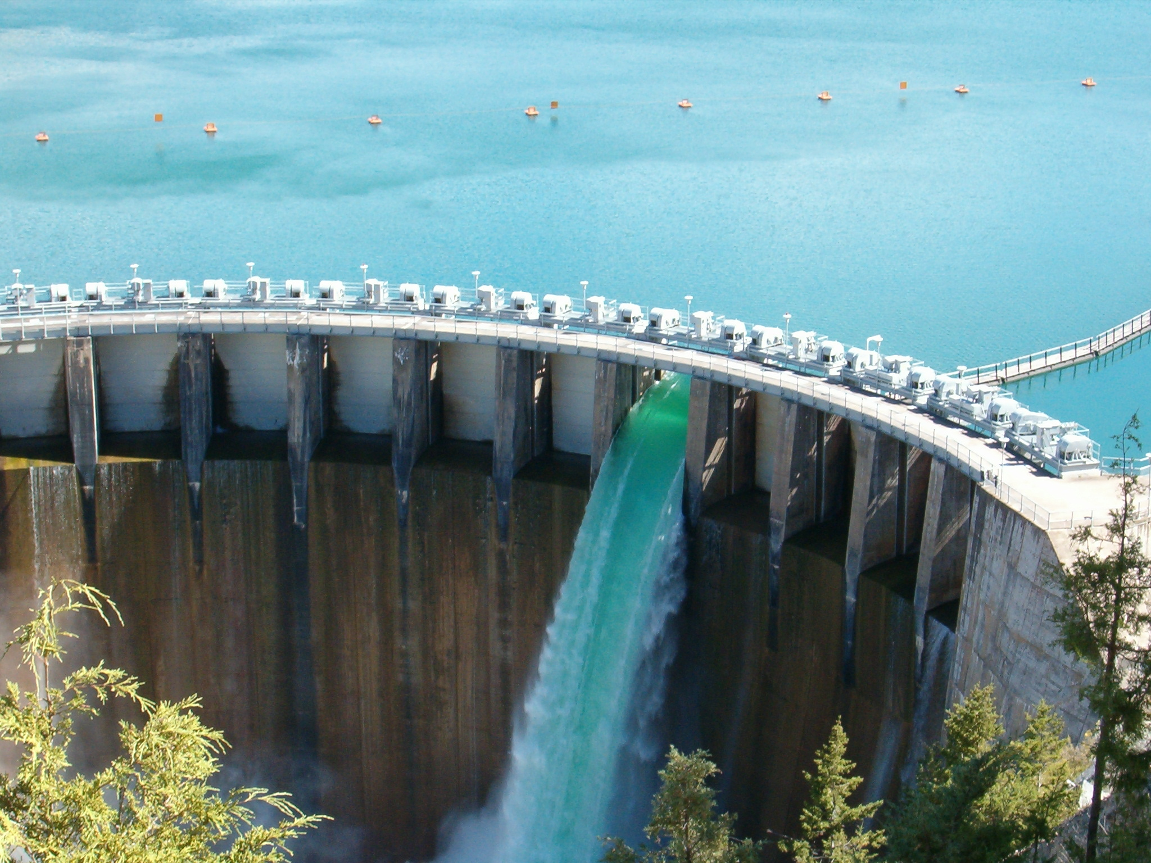
HEC-ResSim Water Quality Model: Reservoir Operations
Water managers needed a reservoir operations model capable of integrating environmental objectives into reservoir release decisions.
We developed water quality simulation capabilities for HEC-ResSim
We leveraged the ClearWater modules (TSM, NSM, etc.) to compute the heat budget and water quality kinetics.
We developed a new 1D hydrodynamics and water quality engine, to be shared by other HEC models.
HEC-ResSim-WQ enables water quality and related environmental objectives to directly inform reservoir release decision-making, while providing capabilities for watershed-scale ecosystem assessment and management
Flows influence water quality
Water quality must influence release decision-making

Slide 16
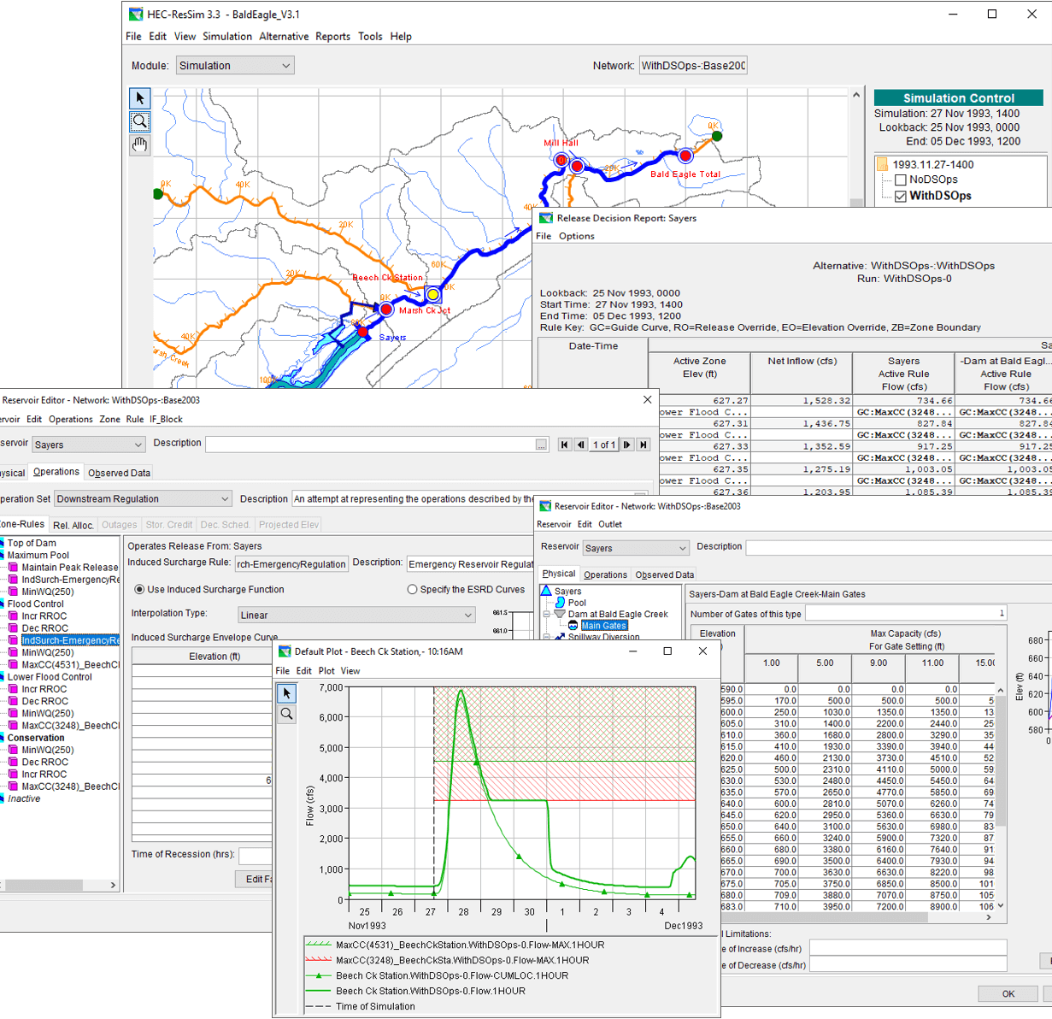
HEC-ResSim Water Quality Model: Reservoir Operations
HEC-ResSim simulates reservoir operations at one or more reservoirs for:
Flood management
Low flow augmentation
Water supply
Applications:
Planning studies
Detailed reservoir regulation plan investigations
Real-time decision support

Slide 17
Integrating Water Quality in Reservoir Release Decision-Making
Old Approach:
WQ was simulated after computing the hydrology and release decisions.
WQ operation rules were specified indirectly (using stage and flow) to meet environmental objectives.
Environmental objectives were often combined with other objectives, like navigation, flood control, or hydropower.
If the desired environmental benefits of an alternative are not achieved, new guesses need to be made, and the simulation recomputed. This stage has often been neglected.
Old Approach
New Approach
New Approach:
WQ is simulated in parallel with the hydrology and release decisions.
WQ operation rules can be specified directly (temperature, concentration, or load) to meet environmental objectives.
Environmental objectives can be specified and managed independently of other objectives, clarifying the environmental impacts of operation decisions.

Slide 18
Integrating Water Quality in Reservoir Release Decision-Making
HEC-ResSim-WQ Integration:
The Flow Engine computes the system flows based on input data and routing parameters.
The Water Engine computes:
1-D vertical hydrodynamics and water quality in the reservoirs
1-D longitudinal flows in the rivers
The Decision Engine evaluates all the specified rules based on the system flows and water quality.
ResSim then computes the releases.
During the simulation, flow and water quality information is saved for post-processing, visualization, and analysis.

Slide 19
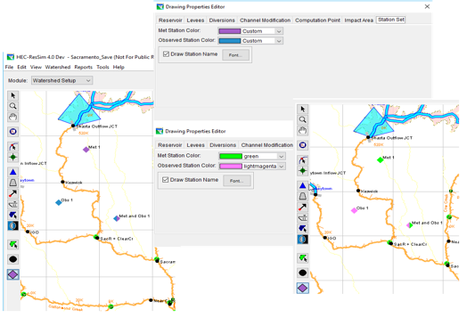
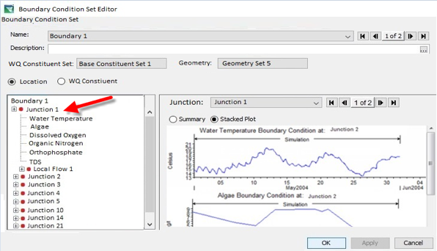
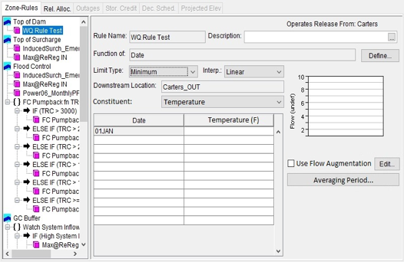
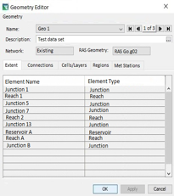
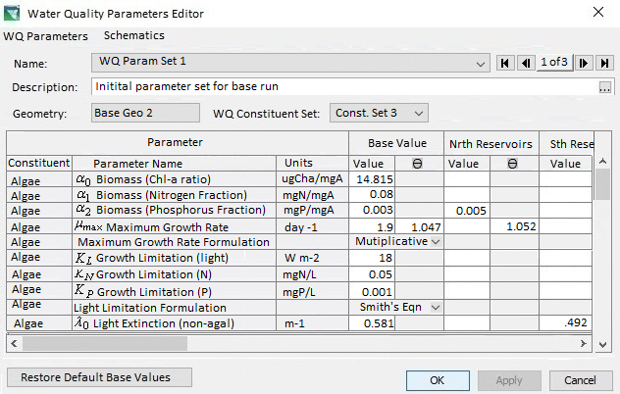
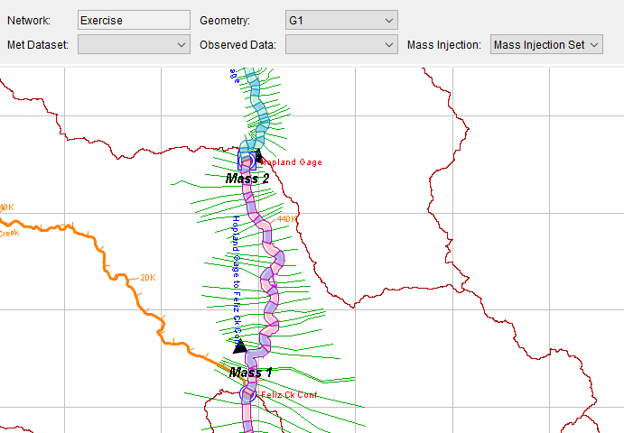
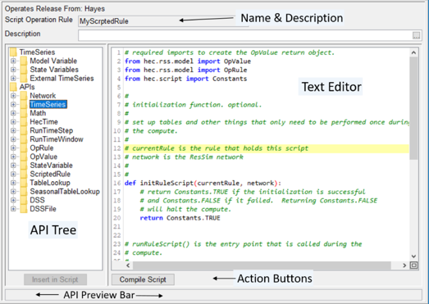
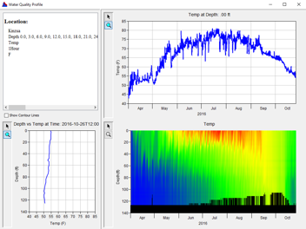
HEC-ResSim Water Quality Modeling User Interface
Model Geometry
Specifying Boundary Conditions
Operating Rule Priorities
Constituent Relation Parameters
Visualization
Scripted Rules and State Variables

Slide 20
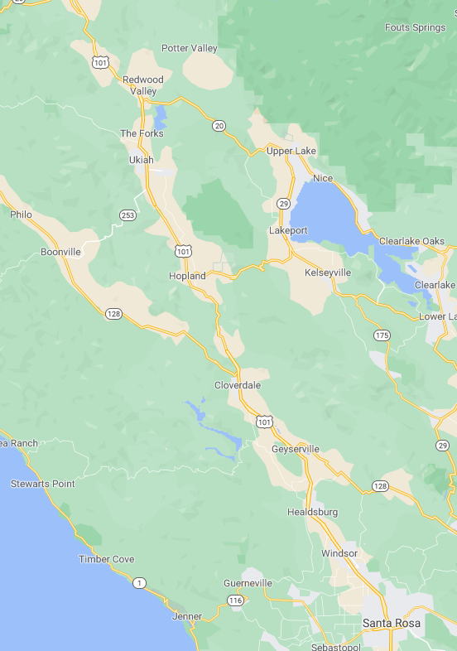
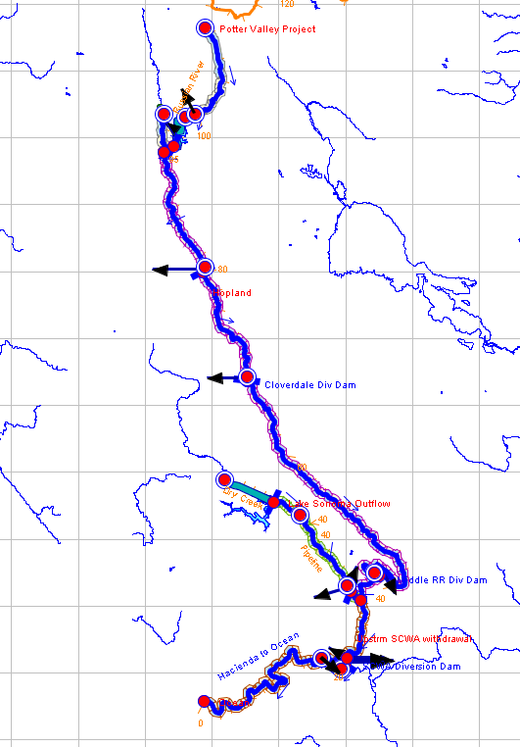
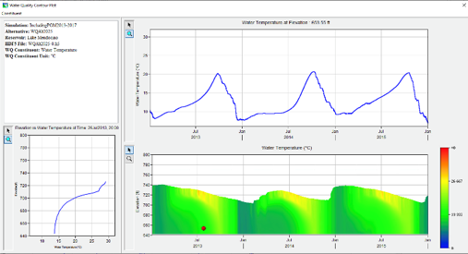

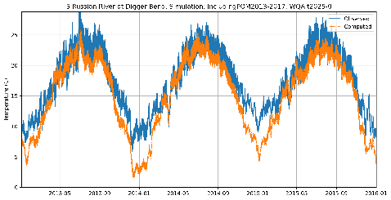
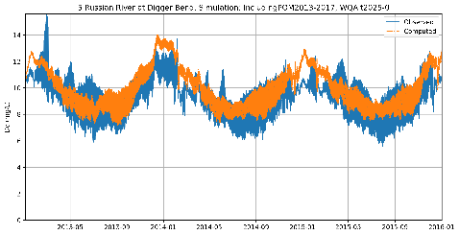
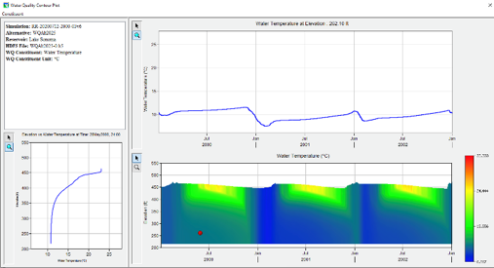
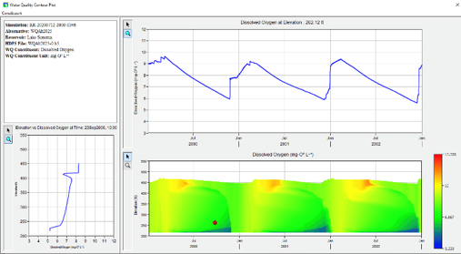
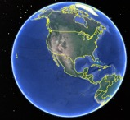
Temperature and Dissolved Oxygen Simulation with HEC-ResSim Russian River, California Prepared by RMA for the Sonoma County Water Agency
Temperature
Dissolved Oxygen
Lake Mendocino
Temperature
Dissolved Oxygen
Lake Sonoma

Slide 21







River Temperature and Cold-Water Pool Management with HEC-ResSim Upper Sacramento River, California Prepared by RMA for the U.S. Bureau of Reclamation (USBR)
Trinity Lake
Shasta Lake
Lewiston Dam
Shasta Temperature Control Device (TCD) graphic courtesy of Watercourse Engineering
Keswick Dam
Whiskeytown Lake

Slide 22


HEC-ResSim-WQ Benefits
HEC-ResSim can compute system flows using rules to determine the outflows that best meet multiple objectives (flood risk management, hydropower, environment, etc.).
HEC-ResSim-WQ is significantly faster than CE-QUAL-W2, which is important for real-time flow and water quality simulations.
For reservoirs with long retention times, HEC-ResSim-WQ achieves accurate temperature simulations.
HEC-ResSim-WQ is capable of rapidly simulating water quality in the unstratified river reaches between dams.
HEC-ResSim’s user interface and extensive operations-based capabilities facilitate model setup, exploration of multiple alternatives, utilization of multiple data sources, visualization of system-wide flows and water quality, scripting of rules, and report generation.
1D Reach
1D Reservoir

Slide 23



Comparison of HEC-ResSim and CE-QUAL-W2 Model Results Water Temperature Profiles: Shasta Lake, California
Prepared by RMA for USBR Water Temperature Modeling Platform (WTMP)

Slide 24


Comparison of HEC-ResSim and CE-QUAL-W2 Model Results Water Temperature Profiles: Shasta Lake, California
Statistics | 2014
 | ResSim_T_Mix-2014 | S14-KesW2-River-2014
Mean Bias (°C) | 0.25 | 0.29
MAE (°C) | 0.36 | 0.40
RMSE (°C) | 0.49 | 0.49
Nash-Sutcliffe (NSE) | 0.95 | 0.95
Error Statistics based on comparison with Observed Daily Flow-Weighted Average Tailbay Temperature
Prepared by RMA for USBR Water Temperature Modeling Platform (WTMP)

Slide 25
Integrated Approach for Effective Reservoir Water Quality Modeling
CE-QUAL-W2 and HEC-ResSim can be used in conjunction to provide a comprehensive understanding of water quality and ecosystem dynamics in river-reservoir systems and help address the multifaceted water resource management challenges in post-conflict Ukraine.
The detailed environmental simulation capabilities of CE-QUAL-W2 can inform, design, and evaluate real-time HEC-ResSim models.
HEC-ResSim’s features, such as alternatives simulation and report generation can help engage stakeholders in informed multi-objective decision-making for complex river-reservoir systems.
This integrated modeling approach can support Ukraine's environmental recovery and sustainability efforts, providing a foundation for advanced water resource management practices capable of addressing multi-faceted challenges.
1D Reservoir
1D River
2D Reservoir
1D Reservoir
1D River
2D Reservoir

Slide 26

HEC-RAS-2D: Hydrodynamic Simulations
HEC-RAS can perform two-dimensional (2D) hydrodynamic routing within the unsteady flow analysis portion of the program.
2D flow areas in HEC-RAS can be used in several ways. The following are examples of how 2D flow areas can be used to support modeling with HEC-RAS:
Detailed 2D channel modeling
Detailed 2D channel and floodplain modeling
Multiple 2D flow areas in the same geometry
Directly connect multiple 2D flow areas with hydraulic structures
Mixed flow regime. The 2D capability (as well as the 1D) can handle supercritical and subcritical flow, as well as the flow transitions from subcritical to super critical and super critical to subcritical (hydraulic jumps).
2D flow modeling is accomplished by adding 2D flow area elements into the HEC-RAS model in the same manner as adding a storage area.
Notes:
HEC-RAS 2D (Hydrologic Engineering Center - River Analysis System 2D) is module developed by the Hydrologic Engineering Center (HEC), U.S. Army Corps of Engineers (USACE) as an extension to the HEC-RAS hydraulic modeling system. HEC-RAS 2D expands the capabilities of the original 1D modeling approach in HEC-RAS by incorporating two-dimensional (2D) modeling capabilities to simulate flow and water surface profiles in river channels and floodplains.
Unlike the traditional 1D modeling in HEC-RAS, which represents flow characteristics along a river channel, HEC-RAS 2D takes into account the lateral variations in flow and water surface elevation across the entire cross-sectional area of the river and its associated floodplain. It considers the spatial distribution of flow velocities, water depths, and water surface profiles, providing a more detailed representation of complex flow patterns and floodplain inundation.
HEC-RAS 2D employs a finite-volume numerical scheme to solve the shallow water equations, which govern the conservation of mass and momentum in 2D flow. It incorporates various hydraulic features, such as bridges, culverts, levees, and natural topography, allowing for a comprehensive analysis of flow behavior, flood extents, and hydraulic interactions within river systems.
The benefits of using HEC-RAS 2D include:
1. Improved Accuracy: By accounting for lateral variations in flow, HEC-RAS 2D provides a more accurate representation of floodplain inundation and flow dynamics, particularly in areas with complex hydraulic conditions.
2. Detailed Floodplain Analysis: HEC-RAS 2D enables detailed floodplain mapping, identification of flow paths, and evaluation of flood risk and potential impacts on infrastructure and communities.
3. Hydraulic Structure Analysis: The 2D capabilities in HEC-RAS allow for the analysis of flow characteristics around hydraulic structures, such as bridges and culverts, including the assessment of flow velocities, velocities at bridge openings, and floodplain encroachments.
4. Scour and Deposition Analysis: HEC-RAS 2D can assess sediment transport, scour, and deposition patterns, aiding in the evaluation of channel erosion, sedimentation impacts, and riverbed changes.
5. Climate Change Adaptation: The enhanced modeling capabilities of HEC-RAS 2D support the evaluation of the impacts of climate change, sea-level rise, and land use changes on river systems and flood risk.
HEC-RAS 2D is widely used in engineering and water resources management for floodplain mapping, flood risk assessment, bridge and culvert design, floodplain management, river restoration, and flood emergency response planning. It provides valuable insights into flow dynamics, flood extents, and hydraulic interactions within river systems, aiding in informed decision-making for water management and flood risk reduction.

Slide 27

ClearWater-Riverine
Clearwater-Riverine simulates temperature and advanced nutrient cycling in branching river systems and floodplains, incorporating hydrodynamic, water quality, and meteorologic inputs from multiple data sources and models.
Flows: The model grid, volumetric flow, velocities, depths, diffusivity, etc. are provided by existing 2D water resources models.
HEC-RAS (2D)
GSSHA (in progress)
Modules: Water quality kinetics and heat budget simulation capabilities in ClearWater-Riverine are furnished by ERDC's ClearWater modules (e.g., NSM).
Transport: The ClearWater transport engine computes advection-diffusion of heat and mass through the model network.
Framework: The ClearWater framework links all the components together and performs the water quality compute sequence.
Currently design is based on decoupled modeling, i.e., the flows are pre-computed by the hydro models.

Slide 28


Demo Case Study: Sumwere Creek — Domain & Mesh
Coarse Mesh Fine Mesh
Notes:
Flow field is from HEC RAS-2D output in this case
Domain: 200 meters by 200 meters
Fictitious Topography/Bathymetry
- Bathymetry bottom elevation constant at 20 m
- Floodplain elevation constant at 24 m
- Roadway elevation constant at 26 m
Two Unstructured Meshes Tested
- Coarse Mesh: Base Mesh of 10 m by 10 m
- Fine Mesh: Base Mesh of 4 m by 4 m with a 2 m by 2 m refinement within the creek

Slide 29
Demo Case Study: Sumwere Creek — Domain, Mesh, and Hydrodynamic Boundary Conditions
Coarse Mesh Fine Mesh
Upstream: 3 cms
Spring:
1 cms
Powerplant:
0.5 cms
Downstream:
20.75 m
Notes:
HEC-RAS Boundary Conditions
- Upstream Flow for Sumwere Creek constant at 3 cms (1st hour ramping from zero)
- Downstream Stage for Sumwere Creek constant at 20.75 m
- Flow for Cold Spring Creek constant at 1 cms (1st hour ramping from zero)
- Flow for Power Plant Chute constant at 0.5 cms (1st hour ramping from zero)

Slide 30


Demo Case Study: Sumwere Creek — Depth at End of Simulation
Notes:
Profile of the coarse and fine mesh depth results along the magenta line in the plan view plot.
This shows the depth at the upstream boundary at 1.27 m and 1.23 for the coarse and fine mesh, respectively (4 cm difference); these depth difference are due to mesh resolution. This shows approximately 0.5 m of hydraulic head is required to overcome the bed friction for this flow rate. A uniform Manning’s roughness coefficient of 0.06 was used in both meshes.

Slide 31


Demo Case Study: Sumwere Creek — Velocity at End of Simulation
Coarse Mesh Fine Mesh
Notes:
Differences in velocities between the meshes are due to varying spatial resolution in each mesh

Slide 32
Demo Case Study: Sumwere Creek — Temperature Boundary Conditions
Coarse Mesh Fine Mesh
Upstream: 15˚C
Spring:
5˚C
Powerplant:
20-25 ˚C
Notes:
Boundary conditions are the same for both the coarse and the fine mesh.
Designed to show longitudinal mixing across the river
Exploration of different extremes (cool water from spring-fed tributary versus warm water from powerplant)

Slide 33

Demo Case Study: Sumwere Creek — Temperature Boundary Timeseries
Coarse Mesh
Upstream: 15˚C
Spring:
5˚C
Powerplant:
20-25 ˚C
Notes:
Timeseries of boundary conditions (stable, except for powerplant discharge)
Powerplant discharge has two peaks during the day (one in the morning, one in the afternoon)

Slide 34

Demo Case Study: Sumwere Creek — Meteorological Timeseries
Notes:
Meteorological timeseries used as inputs to TSM.
Air temperature and solar heat flux both peak during the day and drop at night.
Timeseries from Arizona (extreme cycles to help capture impact of TSM).

Slide 35





Results – Animation
Coarse Mesh Fine Mesh
Notes:
You can see the mixing.
Ultimately reaches steady state.

Slide 36



Results – Warm Powerplant Inflows
Coarse Mesh Fine Mesh
Notes:
Pulses from powerplant.
Can see a lot more transverse mixing from the powerplant and spring in the fine mesh compared to the coarse mesh.
Can see more detail on the plume of warm water.
This all shows transport very clearly, but what about our energy budget model / TSM?

Slide 37

ClearWater-Riverine Example: E. Coli Transport in the Ohio River

Slide 38



ClearWater Framework Summary
ClearWater’s Python-based framework allows easy integration with powerful interactive visualization packages
Enhanced understanding of complex environmental/ecological outcomes
Iterative analysis and scenario discovery
Multidimensional exploration across time and space
Effective communication of results across teams and stakeholders
Notes:
Building on the shoulders of giants.
We do not build or maintain any of these libraries.

Slide 39
USACE Water Quality Model Benefits
Determine the spread and transformation of nutrients and contaminants in the watershed.
Nutrients and contaminants may spread through river, floodplain, and stormwater environments.
In reservoirs, the vertical location controls chemical reactions related to oxygen and temperature levels.
Understand the timeline of pollution events and ecosystem processes through animations of water quality simulations.
Evaluate ecosystem impacts
Evaluate restoration projects, adaptive management plans, and Nature-based feature designs
Rivers, floodplains, stormwater systems:
Reservoirs:

Slide 40

Questions?

